Slide 1
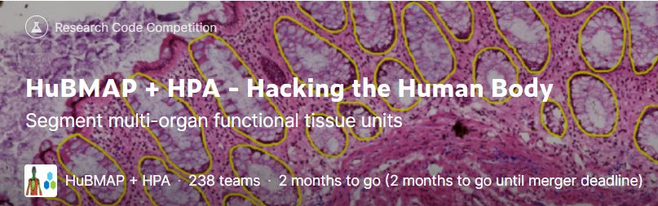
HuBMAP + HPA – Hacking the Human Body
Progress Meeting 5 Group A
https://www.kaggle.com/competitions/hubmap-organ-segmentation

Slide 2
01
Model
CONTENTS
02
Balance the numbers of the tiles
03
Further improvements

Slide 3
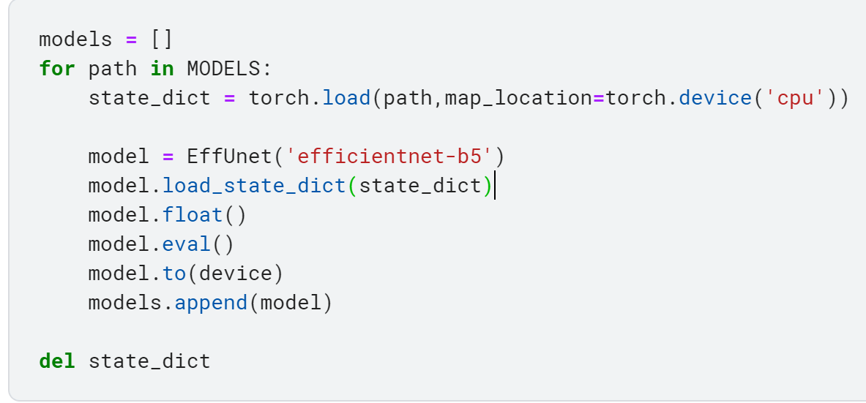
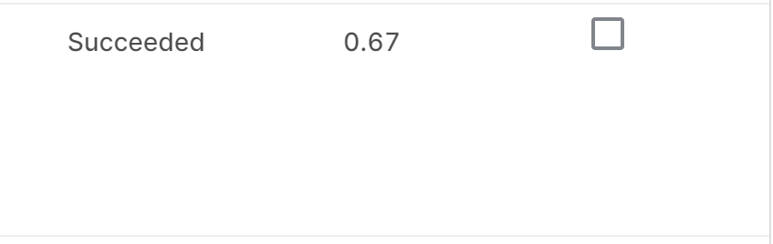
1. EfficientNet-b5
Changed the model part to EfficientNet based on the original Fastai baseline.

Slide 4
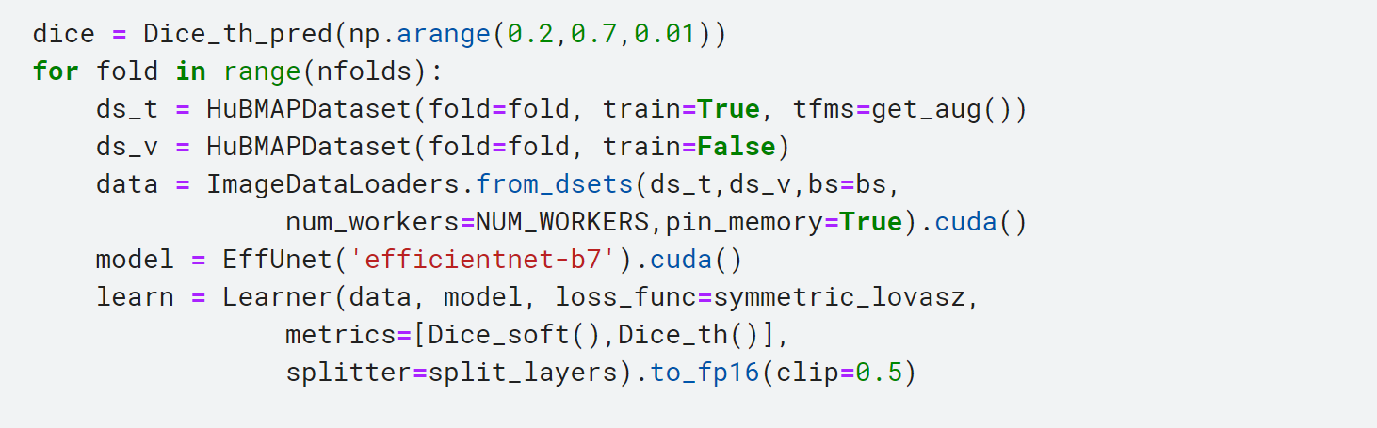

1. EfficientNet-b7
EfficientNet-b7 + expansion(remove edge effect) + Processed dataset

Slide 5
1.Ensemble learning
Introduction:
Ensemble Learning is a way to combine multiple Learning algorithms to achieve better performance. Ensemble in machine learning mainly refers to the combination of limited models with many different structures. It constructed multiple individual learners and then combined them with some strategy to produce a strong learner with good effect to complete the task.
Combination strategy:
Average method. Average method is generally used for regression problems, which is divided into arithmetic average and weighted average.
Voting is generally used for classification questions. Relative majority voting: the class with the largest number in the learner classification result is the final class. Supermajority voting: the number of votes, and must be more than a majority. Weighted voting.
Learning method. Through a learner to combine models, that is, train a number of different models, and then take the output of the previous training of each model as input to train another model, in order to get a final output.
https://www.pianshen.com/article/1239852901/
http://imgtec.eetrend.com/blog/2018/100014627.html

Slide 6
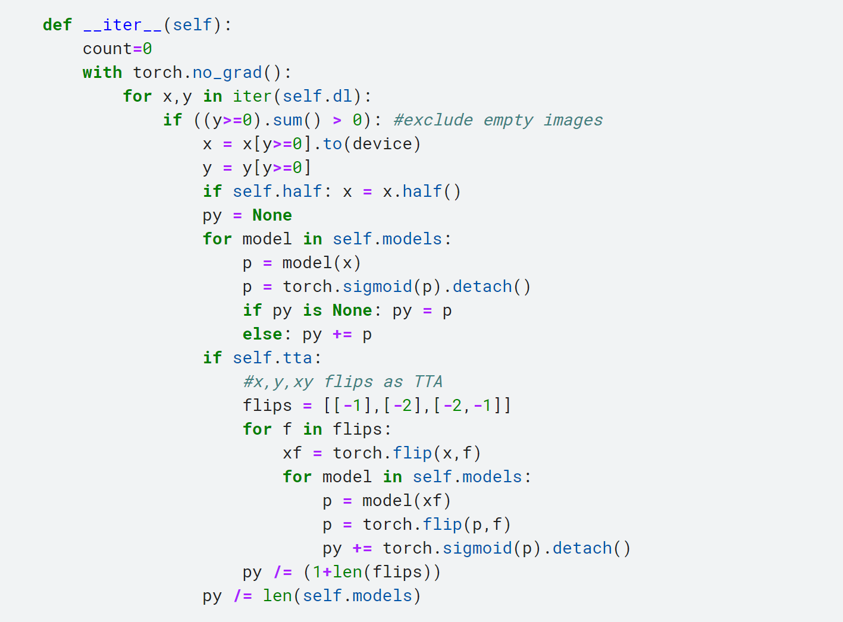
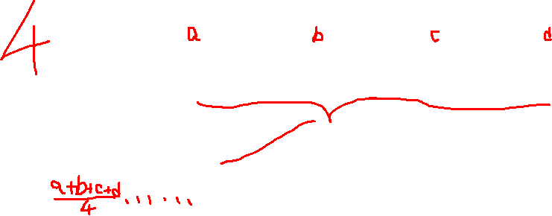
1.Ensemble learning
In previous baseline(fastai with Unext50 baseline):
One ensemble learning method:
Get predict results of four models
Add them together
Calculate average of them
Get average predict result
Other strategies of ensemble learning:
Train more models to get average predict result
Train multiple models with different tile sizes

Slide 7

STRATEGY
BALANCED TILES
From Tom’s notebook, we find that a strategy may help us get better score:
“Balanced tile sampling for training”
Tom implemented this strategy on the kidney dataset, which is very similar to our dataset, but different.
Thus we don't use the same code as Tom to process the dataset.

Slide 8
STRATEGY
BALANCED TILES
Based on the HuBMAP_2022 256x256 dataset, whose data are tiles divided from original dataset, we applied following condition to filter the data:
Remove 20% masks with all 0 and corresponding images.
Remove the mask with few labels (np.sum(mask) < 150 and np.sum(mask) > 0 )
Finally, 253 of 2731 images and 253 of 2731 masks have been removed.
Then, calculate the mean and standard deviation of remaining data.

Slide 9
STRATEGY
SCORE IMPROVEMENT
We use the new dataset to train the original baseline:
There is a slightly improved on scores.

Slide 10
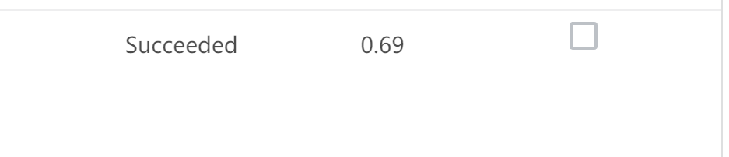
Our attempt
EfficientNet-b5 + Expansion + New dataset(256x256)
Result:
EfficientNet-b7 + Expansion + New dataset(256x256)
Result:

Slide 11
03
Further improvement
We have mentioned many times that the CUDA out of memory problem has plagued us for a long time. Therefore, in order to fundamentally solve this problem, we will use GPU with larger CUDA memory. We will try models with more parameters and try larger data (256x256 → 512x512)
Train multiple models with different tile sizes

Slide 12
Thank You!

